Slide 1
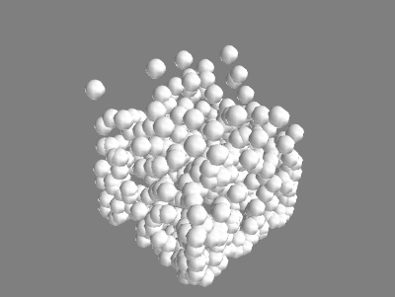
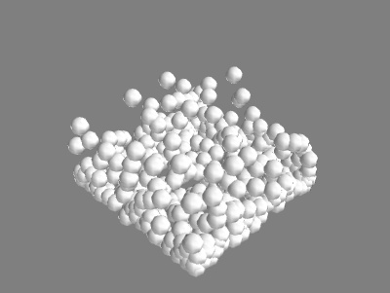
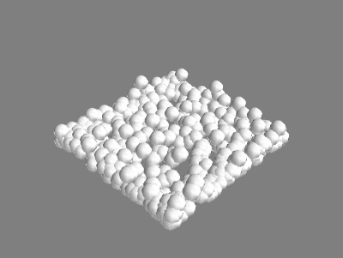
Smoothed Particle Hydrodynamics
International Course in Computational Physics – May 2015
Lennie de Roo, Brandon Ewert, Kenneth Elgin, Aboubakr El Mahdaoui

Slide 2
Introduction
Fluid modeled as a collection of ‘smoothed particles’
- These particles can overlap
- They exhibit cohesion and repulsion forces
- Particles experience viscous drag
Kinematics of particles is very similar to our Molecular Dynamics project

Slide 3
Introduction
Dependencies of Flow:
Speed of sound in medium
Equilibrium density
Viscosity
Elasticity of collisions
Size of droplets
Number of particles
Size of container
External gravity
Time resolution
Drag forces

Slide 4
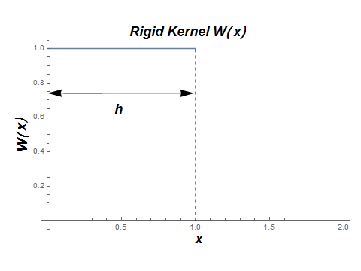
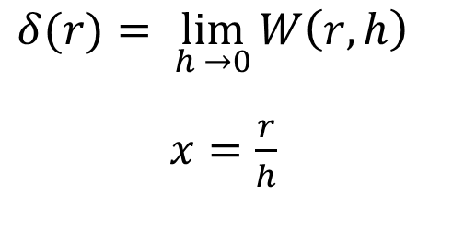
Kernels
Kernels act as a density profile
Discontinuous slopes indicative of solid objects
$$δ(r)= \lim_{h →0}{W\left(r,h\right) }$$
$x=\frac{r}{h}$

Slide 5
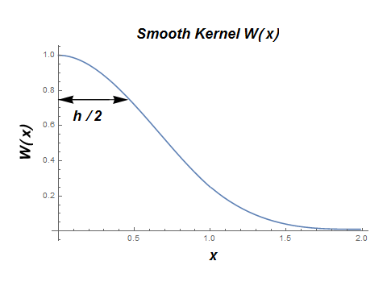

Kernels
Continuous functions used for smoothed objects
Function and derivative must be smoothly connected if defined piecewise
$$W\left(x\right)=\frac{1}{4πh^{3}} \left\{\begin{aligned}{(2−x)}^{3}−4{\left(1−x\right)}^{3} (1>x≥0) \\ {(2−x)}^{3} (2>x≥1) \\ 0 (x≥2)\end{aligned}\right.$$

Slide 6
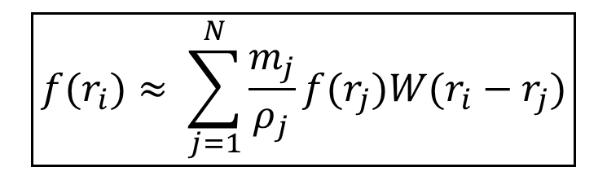
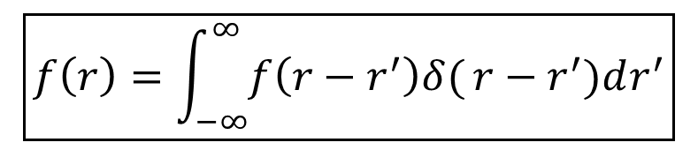
Theory – Applying Kernels
In first grade, we learn:
$$\boxed{f\left(r\right)=\int_{−∞}^{∞}{f\left(r−r^{′}\right)δ(}r−r^{′})dr^{′}}$$
This identity is generalized
$$\boxed{f(r_{i})≈ \sum_{j=1}^{N}{\frac{m_{j}}{ρ_{j}}f(r_{j})W(r_{i}−r_{j})}}$$

Slide 7
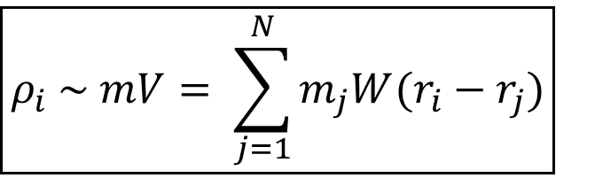
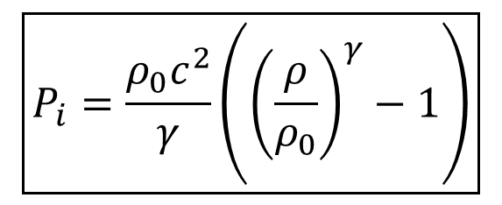
Theory – “Potential”
Potential is replaced by Pressure, Density
$$\boxed{ρ_{i} \sim mV= \sum_{j=1}^{N}{m_{j}W(r_{i}−r_{j})}}$$
From the ideal gas equation of state:
$$\boxed{P_{i}=\frac{ρ_{0}c^{2}}{γ}\left({\left(\frac{ρ}{ρ_{0}}\right)}^{γ}−1\right)}$$
γ is the adiabatic index

Slide 8
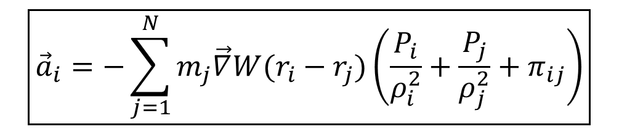
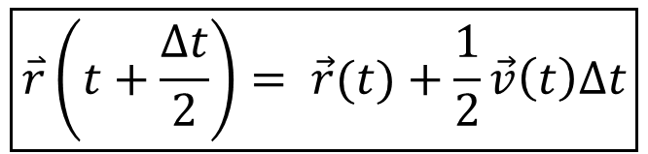
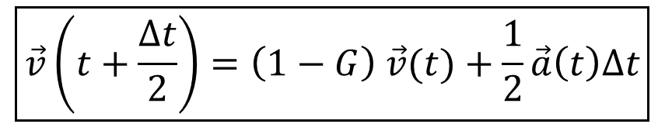
Theory – Kinematics
Acceleration -> Velocity -> Position(Verlet Algorithm)
$$\boxed{{\vec{a}}_{i}=−\sum_{j=1}^{N}{m_{j}\vec{∇}W(r_{i}−r_{j})\left(\frac{P_{i}}{ρ_{i}^{2}}+\frac{P_{j}}{ρ_{j}^{2}}+π_{ij}\right)}}$$
G-term allows for tweaking of drag forces
$$\boxed{\vec{v}\left(t+\frac{∆t}{2}\right)=\left(1−G\right) \vec{v}(t)+\frac{1}{2}\vec{a}\left(t\right)∆t}$$
Verlet Algorithm used to calculate velocity, position
$$\boxed{\overset{⃑}{r}\left(t+\frac{∆t}{2}\right)= \vec{r}(t)+\frac{1}{2}\vec{v}\left(t\right)∆t}$$

Slide 9
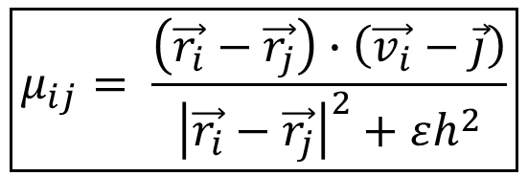
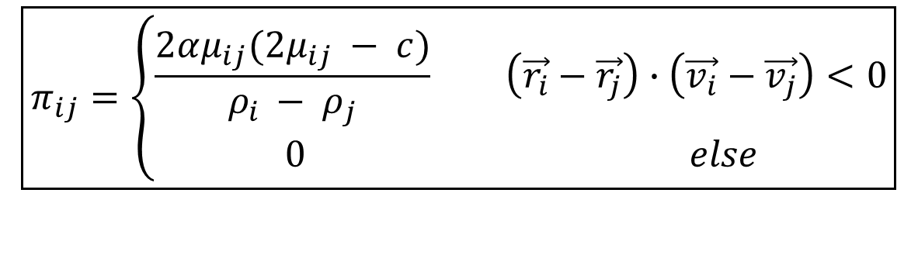
Theory - Viscosity
Viscous drag is only in effect when flow is divergent
α used to tweak the strength of viscosity
$$\boxed{π_{ij}=\left\{\begin{aligned}\frac{2αμ_{ij}(2μ_{ij} − c)}{ρ_{i }− ρ_{j}} \left(\vec{r_{i}}−\vec{r_{j}}\right)∙\left(\vec{v_{i}}−\vec{v_{j}}\right)<0 \\ 0 else\end{aligned}\right.}$$
ε prevents μ from diverging
$$\boxed{μ_{ij}= \frac{\left(\vec{r_{i}}−\vec{r_{j}}\right)∙\left(\vec{v_{i}}−\vec{j}\right)}{{\left|\vec{r_{i}}−\vec{r_{j}}\right|}^{2}+εh^{2}}}$$

Slide 10
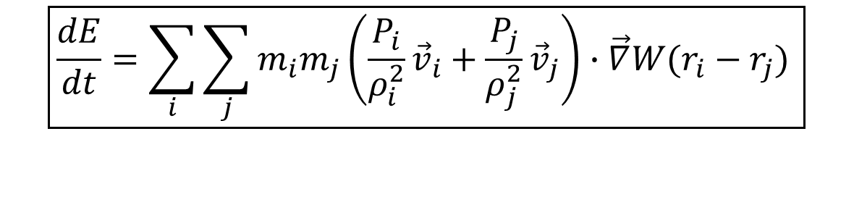
Theory – Energy Conservation
We can check the energy conservation of the system using the following formula:
$$\boxed{\frac{dE}{dt}=\sum_{i}{\sum_{j}{m_{i}m_{j}\left(\frac{P_{i}}{ρ_{i}^{2}}{\vec{v}}_{i}+\frac{P_{j}}{ρ_{j}^{2}}{\vec{v}}_{j}\right)∙\vec{∇}W(r_{i}−r_{j}) }}}$$

Slide 11
Implementation
Determine density for each particle
Calculate pressure on each particle
Use these quantities to find accelerations
Calculate velocity and position
Impose boundaries and correct position/velocity

Slide 12
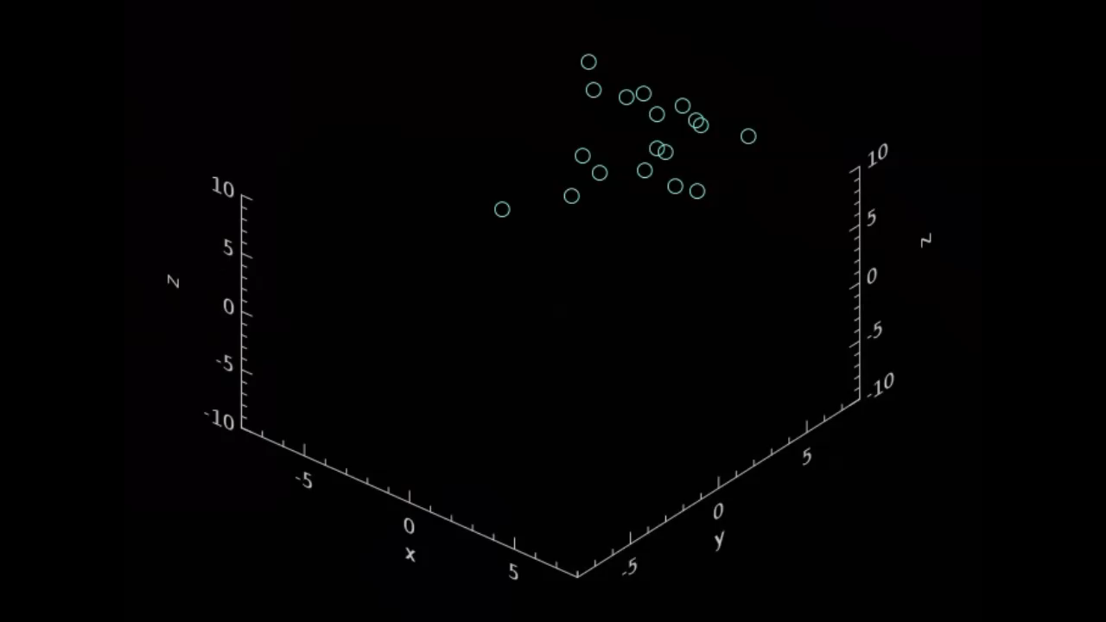
Results

Slide 13
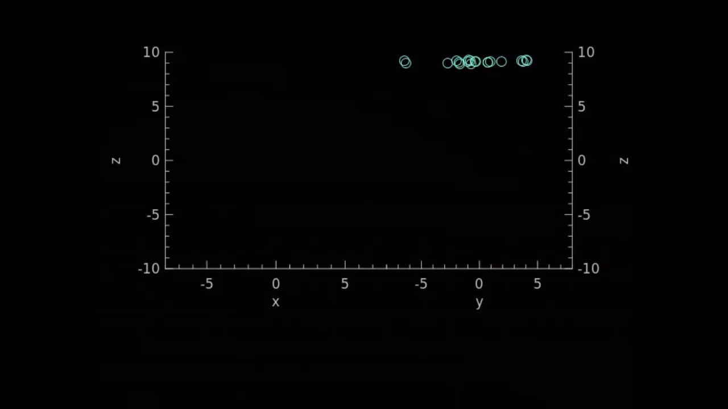
Results

Slide 14
A field trip to VLC…

Slide 15
Conclusion
Flow is highly dependent on parameters
Liquids are finicky
Improvements:
Using different Kernels
Simulating more particles
Tweak parameters to simulate different liquids
More calculations of energy conservation and other relevant physical properties

Slide 16
References
Peter J. Cossins, Smoothed Particle Hydrodynamics Or: How I Learned to Stop Worrying and Love the Lagrangian, 2010
Matthias Müller, David Charypar and Markus Gross, Particle-Based Fluid Simulation for Interactive Applications, 2003
Simon Clavet, Philippe Beaudoin, and Pierre Poulin, Particle-based Viscoelastic Fluid Simulation, 2005
Lucas Braune, Thomas Lewiner, An Initiation to SPH
JOSE

